Slide 1
Which town has the cheapest Resale HDB flat with the highest Rental Yield?
Tan Siew Ling

Slide 2
Datasets used
Median Resale Prices for Registered Applications by Town and Flat Type
https://data.gov.sg/dataset/median-resale-prices-for-registered-applications-by-town-and-flat-type
Resale Flat Prices
https://data.gov.sg/dataset/resale-flat-prices
Median Rent by Town and Flat Type
https://data.gov.sg/dataset/median-rent-by-town-and-flat-type

Slide 3
Scenario
Mr Yang is a 35-year old Singapore PR from China who has worked in Singapore for 10 years.
Currently, He is renting a room for $800 monthly in Jurong East, sharing it with his homemaker wife and 3 year-old son.
Over the years, he has accumulated some money in his CPF and some savings.
He is contemplating buying a HDB flat so that the family can have more space and the monthly room rental of $800 can be invested in a HDB flat for better returns
He currently works in a company located in Jurong East

Slide 4
Scenario
Due to his limited savings and CPF, he has set a budget of $380K for the HDB Flat.
He hopes to rent out one of the rooms for rental income to help to repay the monthly housing loan installments.
In future, he may want to return to China with his family. Then he will have to sell the flat.

Slide 5
Scenario
He would like to find answers to the following questions :
Which type of HDB flat can he afford? 3-room, 4-room or 5-room ? In which towns?
What is the trend in the Historical Resale prices of the selected towns?
Is there any correlation between Age of Flat and Resale Flat prices?
What is the Median age of flats in the selected towns?
Which of the selected towns command the highest rent for a room?

Slide 6
Scenario
To answer his questions, he will perform analysis on :
Median Resale price by Flat Type by Town
Resale Prices by Flat Type by Town
Correlation between Age of Flat and the Resale Price
Age of Flats by Town
Median Rent by Town

Slide 7
Dataset 1 - Median Resale Prices by Town & Flat Type
To find the type of HDB flat that he can afford, Mr Yang decides to plot a Bar Chart for each Flat Type (3-Room, 4-Room and 5-Room), showing the Median Resale prices for the Top 10 towns with the lowest Average Median Resale Prices for the past 6 years using the available data

Slide 8
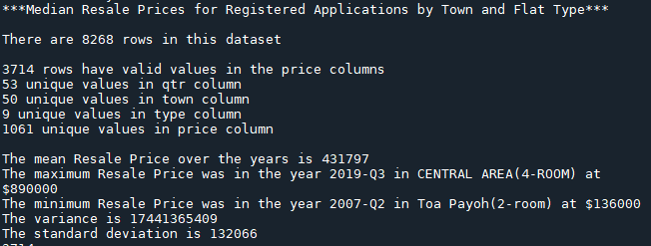
Dataset 1 - Median Resale Prices by Town & Flat Type
Nature of Dataset

Slide 9
Dataset 1 - Median Resale Prices by Town & Flat Type
Data Limitation
There are 8268 records in the data files but only 3714 records have valid Median Resale prices. Most of the records have “na” or “-” in the price column
So some towns may not have sufficient data for comparison. For example, Choa Chu Kang has only a few records for the 3-Room flats for the past 6 years.
Hence, the data may not be sufficient to provide an accurate analysis

Slide 10
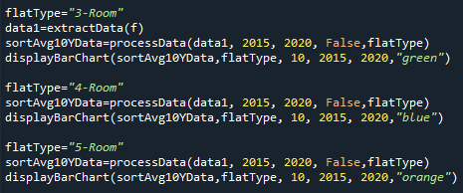
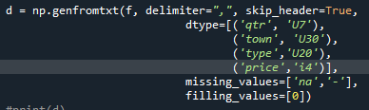
Dataset 1 - Median Resale Prices by Town & Flat Type
Process and Outcome
To plot the Median Resale Prices Bar Chart for each flat type:
Create 3 functions to extract data, process data and plot the bar chart for each flat type. The functions can be called for each flat types
Use numpy genfromtxt to load the data from cvs file into the numpy ndarray.
Data Cleaning - remove rows with missing prices - “na”, “-” :
Filter data by the flat types :

Slide 11

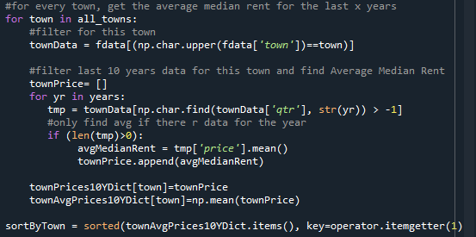
Dataset 1 - Median Resale Prices by Town & Flat Type
Process and Outcome
To find Top 10 towns with lowest Average Median Prices, need to sort the prices in ascending order by town:
Get a list of unique towns from the data using numpy unique function.
Iterate this list to get the Median Resale prices for that town for the past 6 years
Calculate the Average Median Prices
Put it into a Dictionary variable with the town name as the key
Pass Dictionary variable to displayBarChart function to plot the Bar Chart using Matplotlib bar function

Slide 12
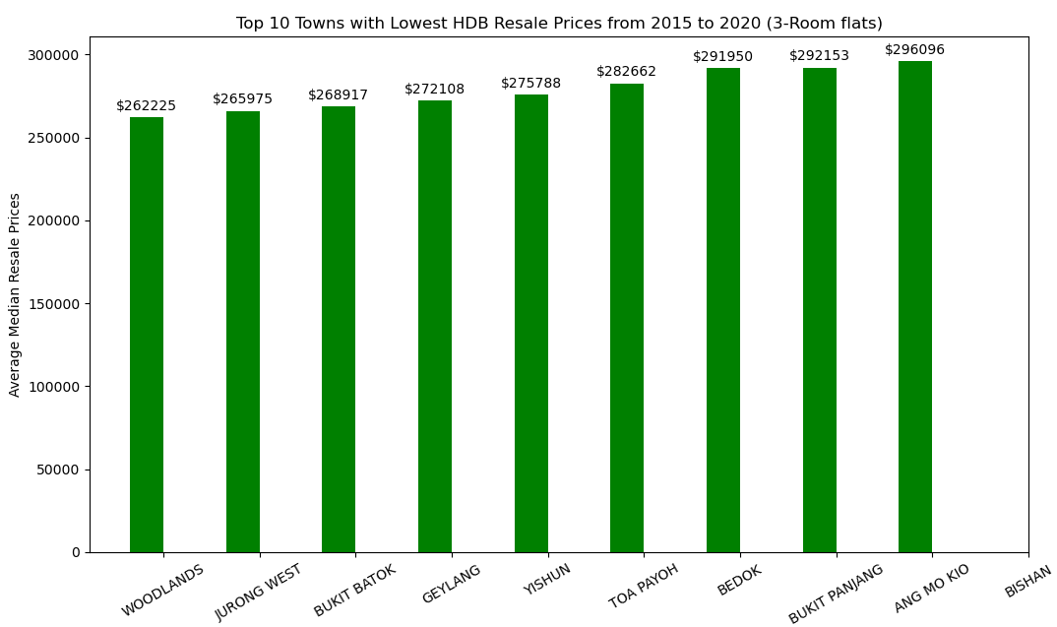
Dataset 1 - Median Resale Prices by Town & Flat Type
Graphical Output - Bar Chart (3-Room Flats)

Slide 13
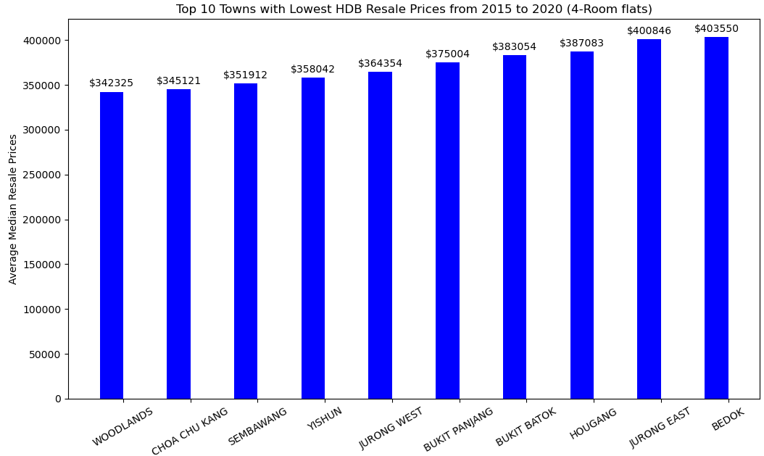
Dataset 1 - Median Resale Prices by Town & Flat Type
Graphical Output - Bar Chart (4-Room Flats)

Slide 14
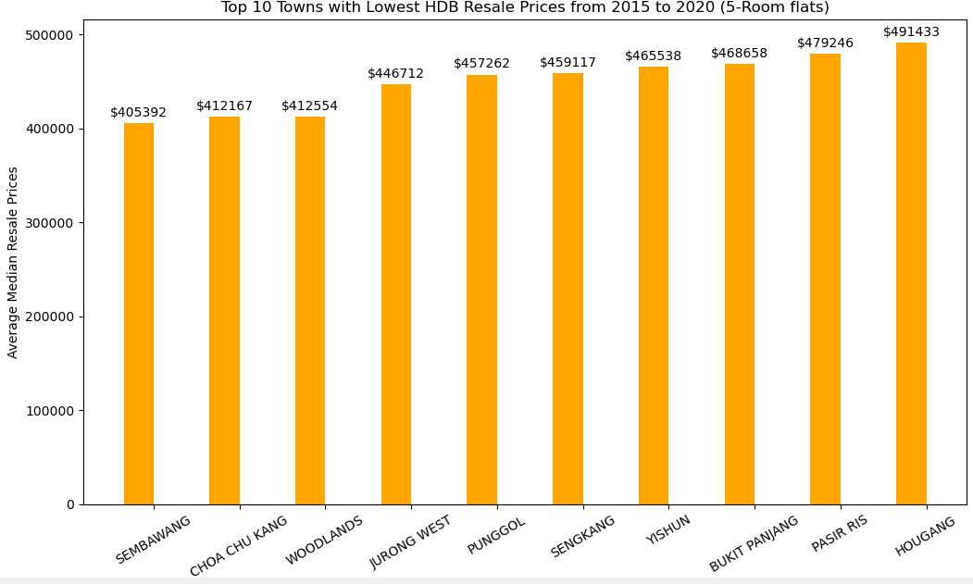
Dataset 1 - Median Resale Prices by Town & Flat Type
Graphical Output - Bar Chart (5-Room Flats)

Slide 15
Dataset 1 - Median Resale Prices by Town & Flat Type
Insights
From the Bar Charts,
Mr Yang can see that he can afford to buy 3-Room flats in most towns in Singapore
He can afford to buy 4-Room flats in some towns namely Woodlands, Choa Chu Kang, Sembawang, Yishun, Jurong West and Bukit Panjang
5-Room flats are out of his budget

Slide 16
Dataset 1 - Median Resale Prices by Town & Flat Type
Conclusion/Recommendations:
Mr Yang would prefer a 4-Room flat to a 3-Room flat as he plans to rent out one room for rental income and his parents and parents-in-laws usually visit them once a year.
As his workplace is in Jurong East, he would prefer a flat nearer to his workplace. So his preferred location for his 4-Room flat will be Woodlands, Choa Chu Kang and Jurong West based on 4-Room Flats Bar Chart

Slide 17
Dataset 1 - Median Resale Prices by Town & Flat Type
After narrowing his search to a 4-Room flat in Woodlands, Choa Chu Kang and Jurong West, Mr Yang plots a Line Chart to analyse the Historical Median Resale Prices of 4-Room flats in these 3 towns over the past 10 years using the available data.
Although the Average Median Resale Price of 4-Room flats in Bukit Batok and Jurong East are out of his budget, he would still want to analyse the prices in these 2 towns further as they are nearest to his workplace and they have been staying in Jurong East for the past 10 years. So he has included these 2 towns in the Line Chart too.

Slide 18
Dataset 1 - Median Resale Prices by Town & Flat Type
Nature of Dataset : as mentioned in the earlier slides
Data Limitation: as mentioned in the earlier slides

Slide 19

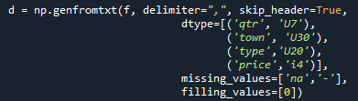
Dataset 1 - Median Resale Prices by Town & Flat Type
Process and Outcome
To plot the Historical Median Resale Prices Line Chart for each of the 5 Selected towns:
Create 3 functions to extract data, process data and plot line chart for all 5 towns.
Use numpy genfromtxt to load the data from file into the numpy ndarray.
Data Cleaning - remove rows with missing prices - “na”, “-” :
Filter data by flat types :

Slide 20
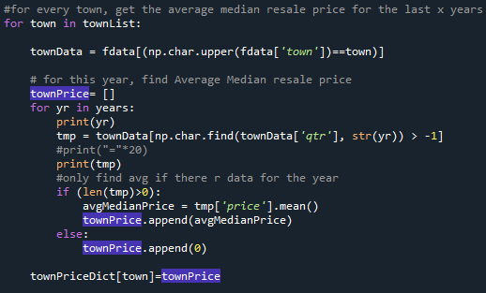
Dataset 1 - Median Resale Prices by Town & Flat Type
Process and Outcome
For each selected town and year
Retrieve the quarterly median resale prices
Calculate the Average Median Resale Price for the year
Put it into a Dictionary variable with the town name as the key
Pass the Dictionary variable to the displayLineChart function to plot the Line Chart using Matplotlib plot function

Slide 21
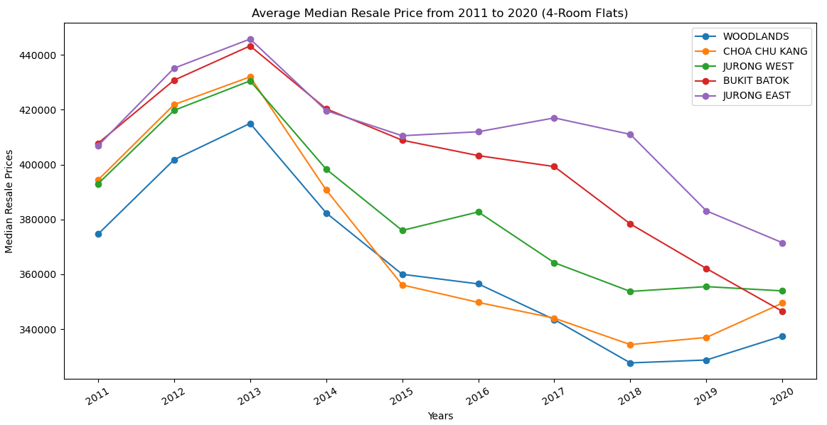

Dataset 1 - Median Resale Prices by Town & Flat Type
Graphical Output - Line Chart

Slide 22
Dataset 1 - Median Resale Prices by Town & Flat Type
Insights
HDB 4-Room flat Resale Prices are on a downward trend for the past 7 years for all the 5 towns
The Resale Prices of 4-Room flat in Woodlands and Choa Chu Kang have rebounded slightly over the recent 2 years.
The Median Resale Price in 2020 for the 5 towns are within Mr Yang’s budget.
Jurong East has the highest Median Resale price as it has been developed into a Regional Center with close proximity to many amenities and commericial developments

Slide 23
Dataset 1 - Median Resale Prices by Town & Flat Type
Conclusion/Recommendations:
Since the Median Resale Prices of Jurong East and Bukit Batok in 2020 are within his budget, he can now also consider a 4-Room flat in Jurong East and Bukit Batok which are nearer to his workplace.
The HDB 4-Room Resale Prices in Jurong East and Bukit Batok are still on a downward trend and have not start rebounding yet. So it is a good time to buy a flat in these 2 towns.

Slide 24
Dataset 2 - Resale Flat Prices
In future, Mr Yang may want to return to China with his family. As HDB Flats have only a 99-year lease, he is concerned that if he buys a flat now and by the time he wants to return to China, he may have difficulties selling his flat with little lease left for a good price.
He would like to analyse if there is any correlation between the Age of Flat and Resale Flat prices
He decided to plot a Scatterplot on Age of flat against the Resale Price for each town using the past 6 years of available data

Slide 25
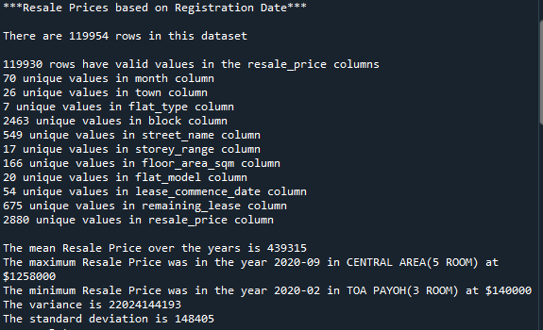
Dataset 2 - Resale Flat Prices
Nature of Dataset

Slide 26
Dataset 2 - Resale Flat Prices
Data Limitation
As the data used is the Resale Flat transactions, the analysis is only based on the 4-Room flats being sold, not the entire 4-Room flats in the town. Hence, it may not reflect the true age of the all 4-Room flats in the town

Slide 27
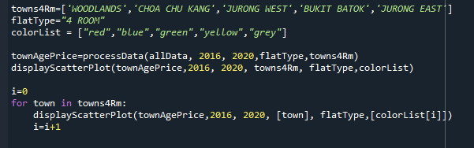
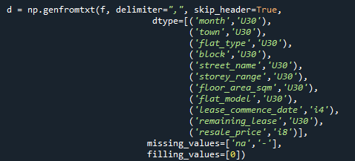

Dataset 2 - Resale Flat Prices
Process and Outcome
To plot the Scatter plot for each town
Create 3 functions to extract data, process data and plot scatterplot for all 5 towns.
Uses numpy genfromtxt to load the data from file into the numpy ndarray.
Data Cleaning - remove rows with missing prices - “na”, “-” :
Filter data by flat types

Slide 28
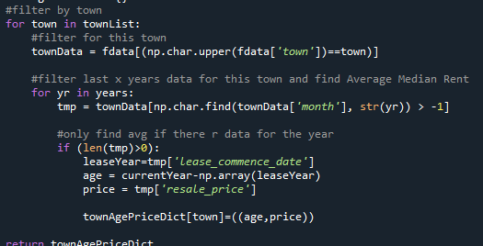
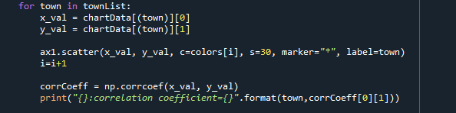
Dataset 2 - Resale Flat Prices
Process and Outcome
For each selected town,
Retrieve the resale transaction data for the past 6 years
Calculate the Age for the flat being sold by subtracting the Lease Commence Date (Year) from the current year
Put it into a Dictionary variable with the town name as the key
Pass Dictionary variable to displayScatterplot function
Plot the Scatterplot for all the selected towns using Matplotlib scatter function and calculate the correlation cofficient

Slide 29
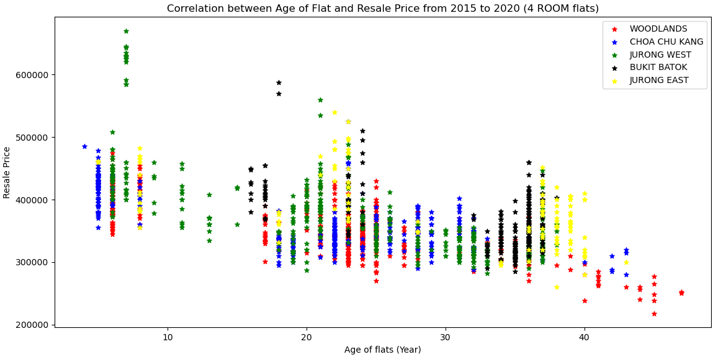

Dataset 2 - Resale Flat Prices
Graphical Output - Scatterplot (all 5 towns)

Slide 30
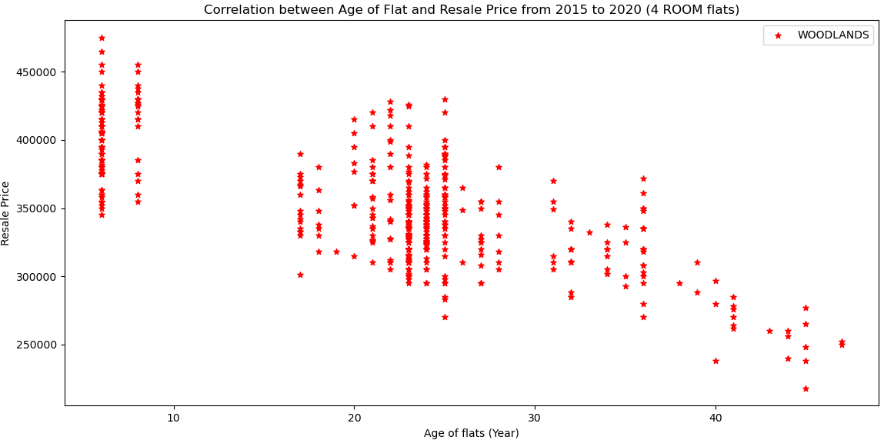
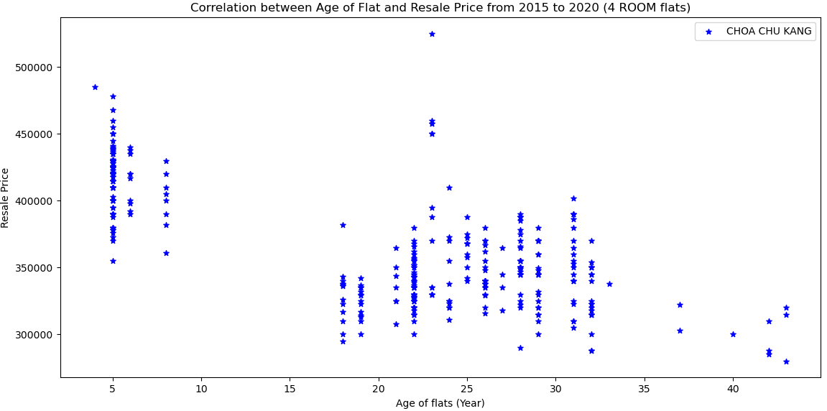
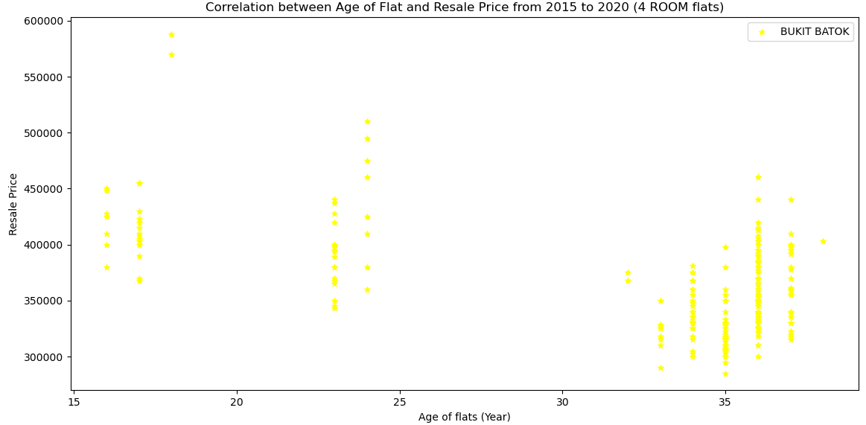
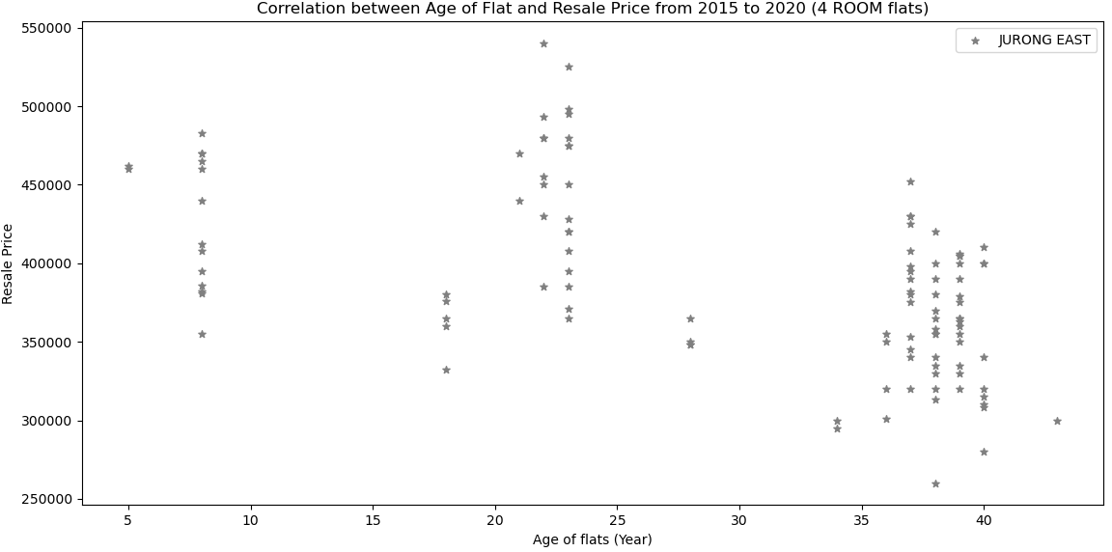
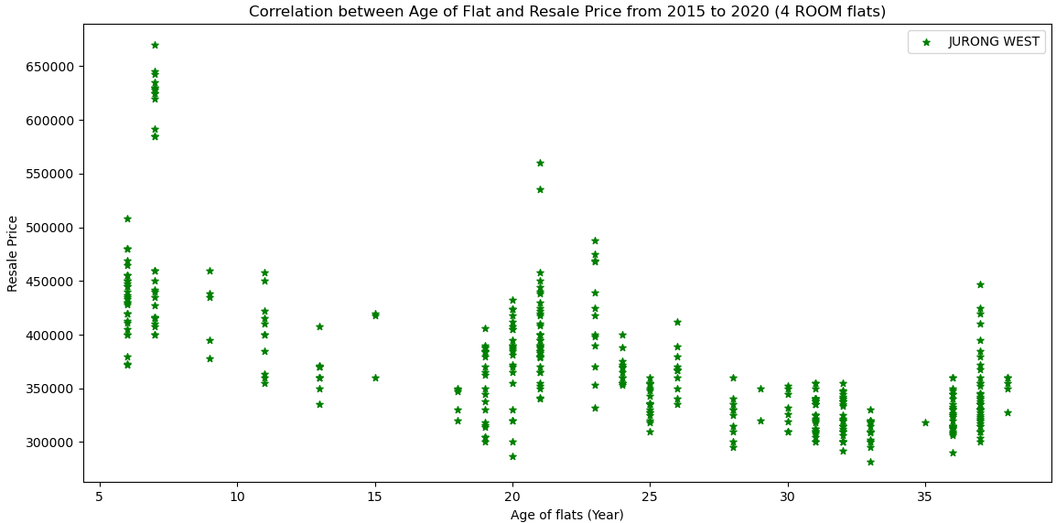
Dataset 2 - Resale Flat Prices
Graphical Output - Scatterplot (for each town)

Slide 31
Dataset 2 - Resale Flat Prices
Insights
The Scatterplots show a moderate (for Jurong East, Bukit Batok and Jurong West) to fairly strong (for Woodlands and Choa Chu Kang) negative relationship between Age of flats and Resale Prices for all 5 towns.
This mean that the Older the flat, the lower the Resale Price will be.
This is logical as HDB flats comes with only a 99 year lease. However, in more central location, this correlation may be even lower due to stronger demand.

Slide 32
Dataset 2 - Resale Flat Prices
Conclusion/Recommendations
Since there is some correlation between the Age of the flat and the Resale Prices, Mr Yang should look for a flat in Jurong East, Bukit Batok or Jurong West where the correlation is moderate. This will help to preserve more of the Resale value of his flat when he wants to sell it to return to China

Slide 33
Dataset 2 - Resale Flat Prices
From the Scatterplots for each towns, he noticed that some towns have more aging flats than others (>30 years old)
With great concern over the negative correlation between the Age of flat and Resale Prices, Mr Yang now wants to analyse the Age of flats in all the 5 towns for the past 5 years.
He decided to plot a box plot for the Age of flats in each town and compare them

Slide 34
Dataset 2 - Resale Flat Prices
Nature of Dataset: as mentioned in previous slides
Data Limitation: as mentioned in previous slides

Slide 35
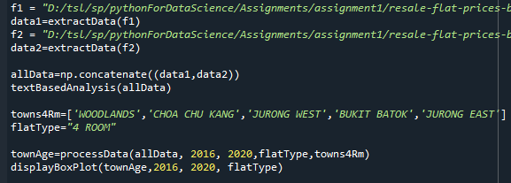
Dataset 2 - Resale Flat Prices
Process and Outcome
To plot the Box plot for each town
Create 3 functions to extract data, process data and plot scatterplot for all 5 towns.
Use numpy genfromtxt to load the data from file into the numpy ndarray.
Data Cleaning - remove rows with missing prices - “na”, “-” :
Filter data by flat types

Slide 36

Dataset 2 - Resale Flat Prices
Process and Outcome
For each selected town,
Retrieve the resale transaction data for the past 5 years
Calculate the Age for the flat being sold by subtracting the Lease Commence Date (Year) from the current year
Put it into a Dictionary variable with the town name as the key
Pass the Dictionary variable to displayBoxPlot function
Plot the Box plot for all the selected towns using Matplotlib boxplot function

Slide 37
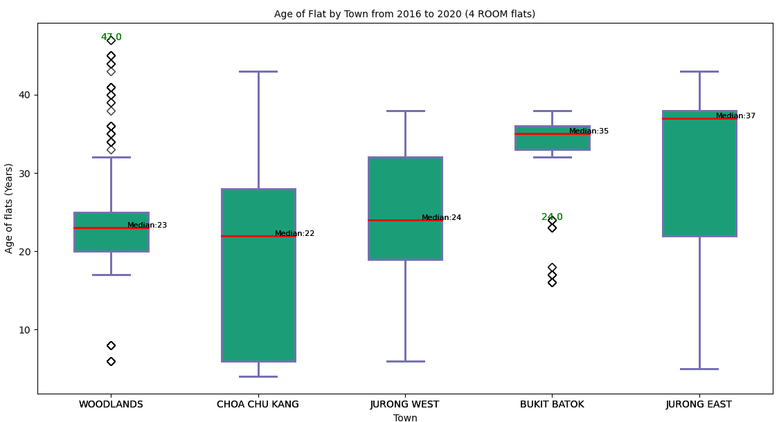
Dataset 2 - Resale Flat Prices
Graphical Output - Boxplot of Age of Flats (all 5 towns)

Slide 38
Dataset 2 - Resale Flat Prices
Insights
The Box plots of the 5 towns revealed that :
Median Age of Flats in Bukit Batok and Jurong East is more than 30 years old (35 and 37 years old respectively). This means that more than 50% of the flats in these 2 towns are more than 35/37 years old, with more than one-third of their 99 year lease used up.
The entire box plot of Bukit Batok is located above the 30 years mark with some outliers below the 30 years mark. This may indicates that majority of the 4-Room flats in Bukit Batok being sold are more than 30 years old. Hence, it may be difficult to find a younger flat (less than 30 years old) in this town

Slide 39
Dataset 2 - Resale Flat Prices
Insights
Median Age of Flats in Woodlands, Choa Chu Kang and Jurong West are relatively younger (23,22,24 years old respectively)
Age of flats in Woodlands and Bukit Batok flats being sold have less variation (smaller IQR, more consistency) compared to the other 3 towns. For Woodlands, the IQR is between 20 and 25 only. However, there are quite a number of outliers (older flats between 30 to 50 years) in Woodlands.
The box plots in all towns are left/negatively skewed except Jurong West which is right skewed . This means that the mean Age is less than the median Age.

Slide 40
Dataset 2 - Resale Flat Prices
Insights
Choa Chu Kang have more variation (largest IQR among all towns, less consistency) in Age of Flats being sold compared to the other owns and left skewed. There are more younger flats in this town (more than 50% are less than 22 years old)

Slide 41
Dataset 2 - Resale Flat Prices
Conclusion/Recommendations:
Mr Yang can consider getting a 4-Room flat in Woodlands, Choa Chu Kang and Jurong West as they are much younger. This will help to preserve the Resale Price of the flat so that it will be easier to sell it off when he wants to return to china
Since Age of flats in Choa Chu Kang has more variations and majority of the flats being sold are younger (50% are less than 22 years old) , it will be easier for Mr Yang to purchase a younger flat in this town

Slide 42
Dataset 3 - Median Rent by Town and Flat Type
Since Mr Yang plans to rent out one room to have some rental income to help to repay his monthly housing loan installments, he needs to analyse the Median Rent for all the 5 towns
He decided to plot a Line Chart comparing the Median Rent for all 5 towns over the past 10 years.

Slide 43
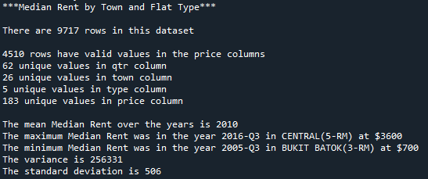
Dataset 3 - Median Rent by Town and Flat Type
Nature of Dataset

Slide 44
Dataset 3 - Median Rent by Town and Flat Type
Data Limitation
Mr Yang is more interested in the Median Rent for a common room for each town. However, there is only data for the Median Rent for the whole 4-Room flat for each town.
We have to assume that the Median Rent for the whole 4-Room flat is proportional to the Median Rent for a common room in a 4-Room flat.

Slide 45
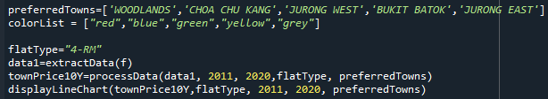
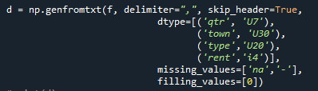
Dataset 3 - Median Rent by Town and Flat Type
Process and Outcome
To plot the Median Rent Line Chart for each town
Create 3 functions to extract data, process data and plot line chart for all 5 towns.
Uses numpy genfromtxt to load the data from file into the numpy ndarray.
Data Cleaning - remove rows with missing prices - “na”, “-” :
Filter data by flat types :

Slide 46
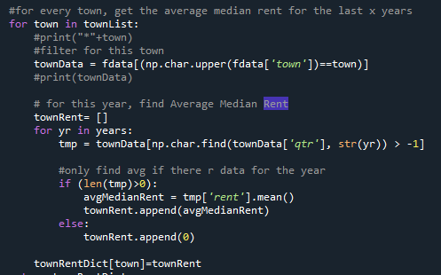
Dataset 3 - Median Rent by Town and Flat Type
Process and Outcome
For each selected town,
Retrieve the data for each quarter
Calculate the Average Median Rent for each year in the past 10 years
Put it into a Dictionary variable with the town name as the key
Pass Dictionary variable to displayLineChart function
Plot the Line Chart for all the selected towns using Matplotlib plot function

Slide 47
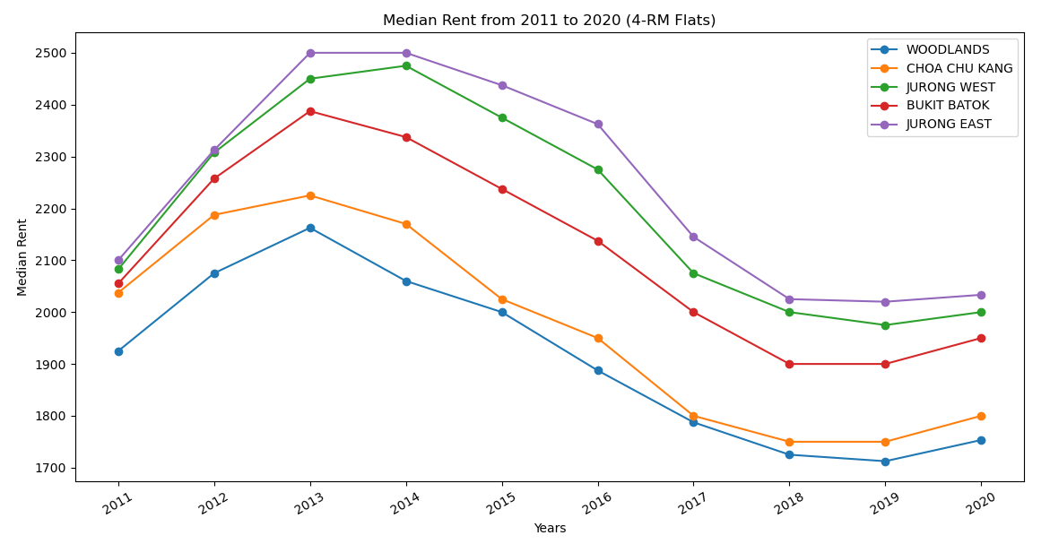

Dataset 3 - Median Rent by Town and Flat Type
Graphical Output - Line Chart (all 5 towns)

Slide 48
Dataset 3 - Median Rent by Town and Flat Type
Insights
The Top 3 towns with highest median rent are Jurong East, Jurong West and Bukit Batok
Woodlands has the lowest median rent
Jurong East has the highest median rent which also has the highest resale price among the 5 selected towns. This is possibly due to its Regional Center status and has a good balance of commercial and residential development which is an attractive local to rental tenants in the nearby universities and the western technological corridors (Science Parks, Business Parks and new suburban offices in Jurong East).

Slide 49
Dataset 3 - Median Rent by Town and Flat Type
Conclusion/Recommendations:
Mr Yang should get a 4-Room flat in Jurong East if he wants to get a higher rental income from one of his common room

Slide 50
Summary
Recommendations:
With his budget, it is recommended that Mr Yang should get a 4-Room flat in Jurong East if he wants to get a higher rental income from one of his common room. It will also be easier to rent out his room.
On the downside, since there are less flats aged less than 20 years iin Jurong East, it will be harder to find such flats and he may have to pay more for it.
If he prefers a younger flat, he can get a 4-Room flat in Choa Chu Kang but he will have to settle for a lower rental income.

